Slide 1

Hybridisation and splitting of a crank angle resolved internal combustion engine using a mean value intake for real-time performance
Xiaoran Han, Alessandro Picarelli, Mike Dempsey and Romain Gillot
Claytex Services Limited
October 10, 2018
Notes:
dfhgfsgsdfgdsfgsdf

Slide 2
Agenda
Who are Claytex?
What is Crank Angle Resolved Engine Model (CAREM)?
Splitting CAREM to run on multi-core processor, with/without feedback loops.
What is Mean Value Engine Model (MVEM)?
Use of MVEM in CAREM combustion simulation.
Performance evaluation of MVEM with CAREM combustion in Dymola.
Real-Time performance evaluation of MVEM with CAREM combustion on hardware.
Calibration of MVEM using controller design.
Automation of calibration process.
Summary.

Slide 3

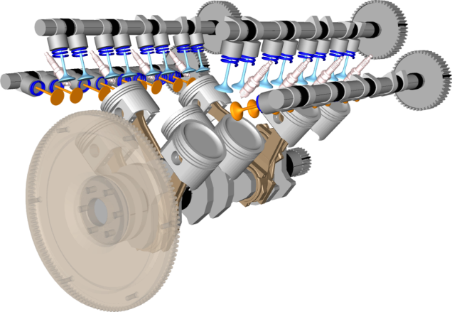
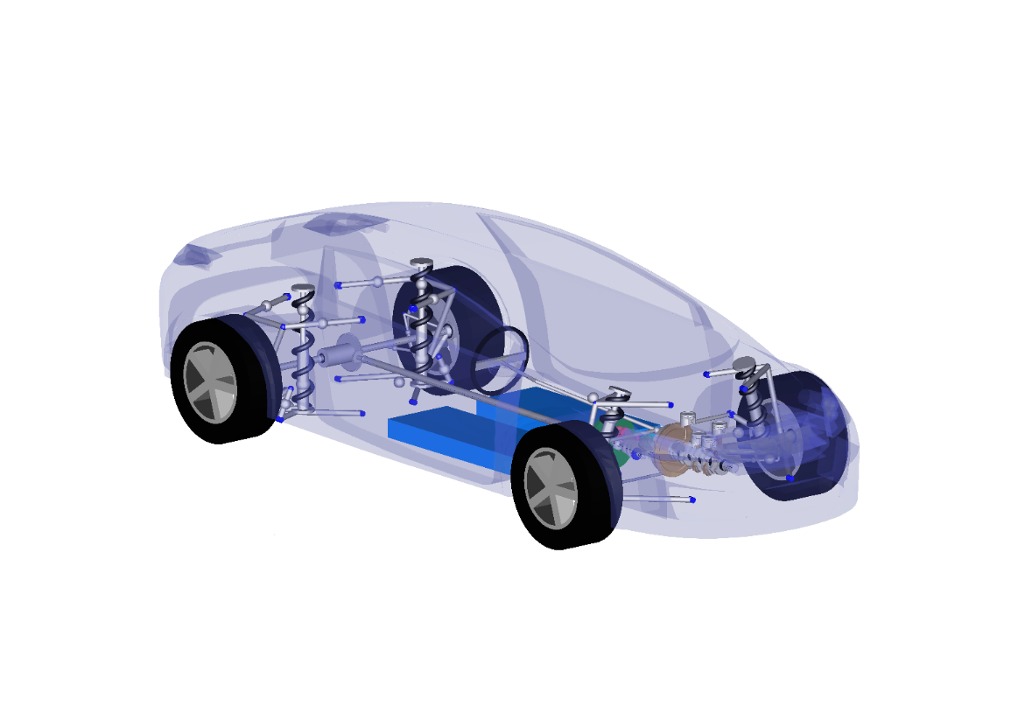




Who are Claytex?
Model-based engineering analysis consultancy
Innovators in CAE process
Leading the way on zero-prototype development
Specialists in high-fidelity real-time simulation
Users of Dymola and Modelica since 1999
Provider of software solutions for systems engineering
Dymola distributors since 2003
Dassault Systemes partner since 2008
rFpro system integrator and distributor since 2009
Modelica library and FMI tool developers
Dassault Systemes Certified Education Partner
Offices in the UK, USA and South Africa
Major customers include Automotive OEM’s, suppliers and Motorsport teams (Formula 1, NASCAR, Indycar, Formula E)

Slide 4

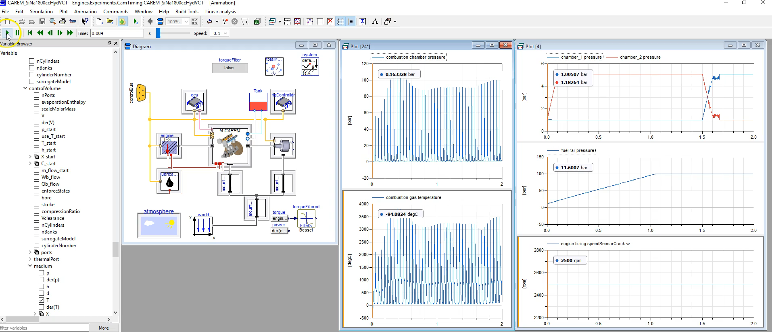
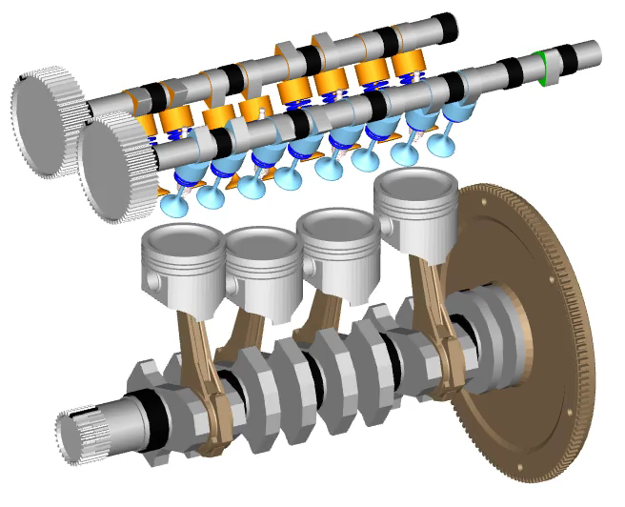
For Engines
For controller validation we need real-time engine models with instantaneous air-flow, combustion and torque prediction

Slide 5
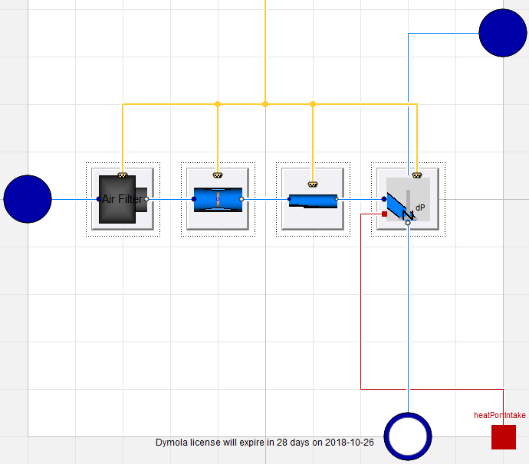
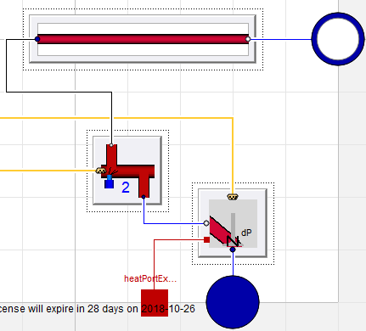
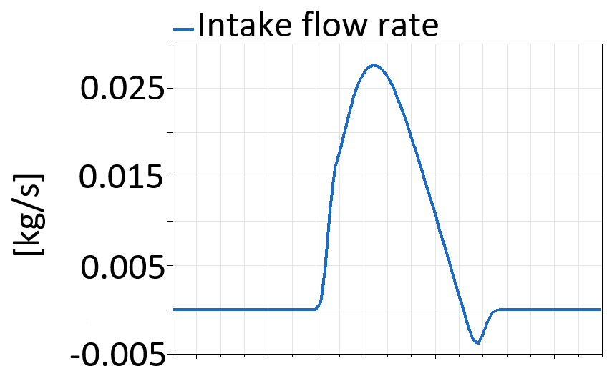
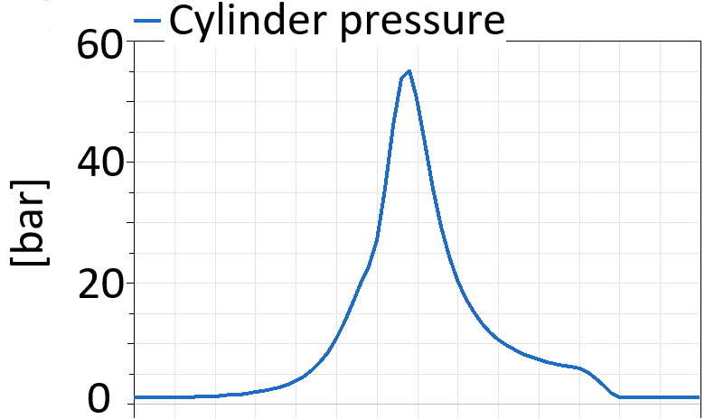
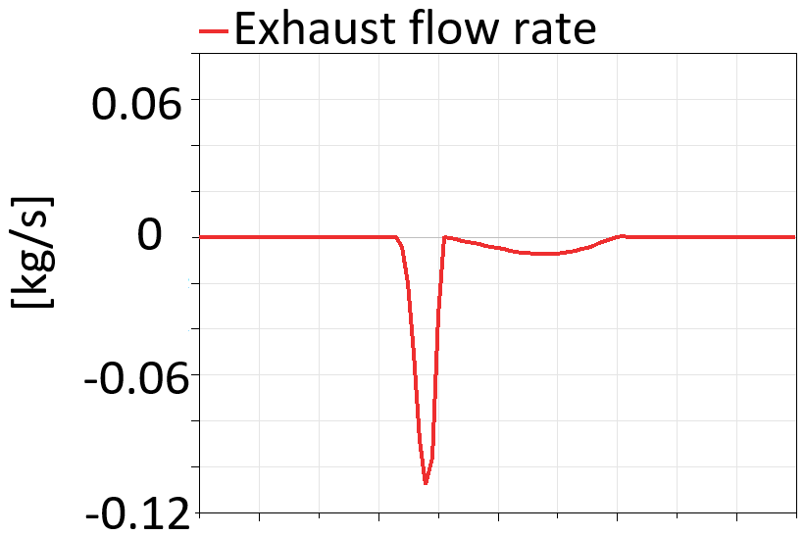
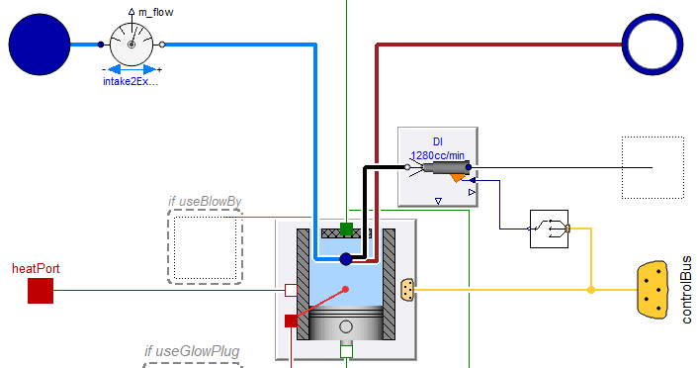
Crank angle resolved engine Model (CAREM)
What is Crank Angle Resolved Engine Model?
Predicts the instantaneous torque and air flow through the engine
1D thermofluid components (valves, orifices, volumes) to model instantaneous quantities (pressure, temperature, mass flow rate, species) through intake, exhaust and combustion chamber
Intake system
Exhaust system
Air filter
Secondary exhaust
Throttle
Primary exhaust
Plenum
Exhaust valve
Injector
Intake valves
Combustion chamber

Slide 6
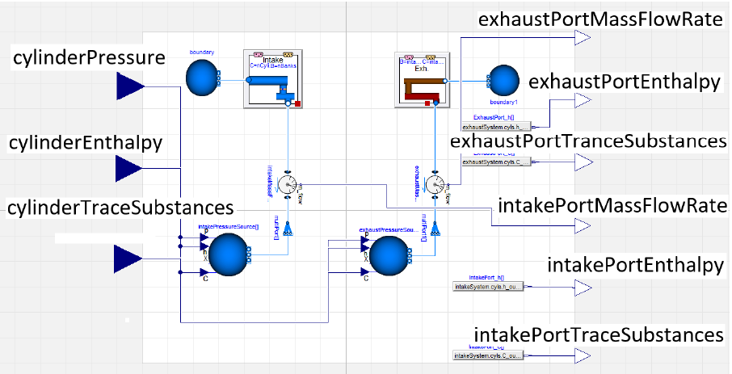
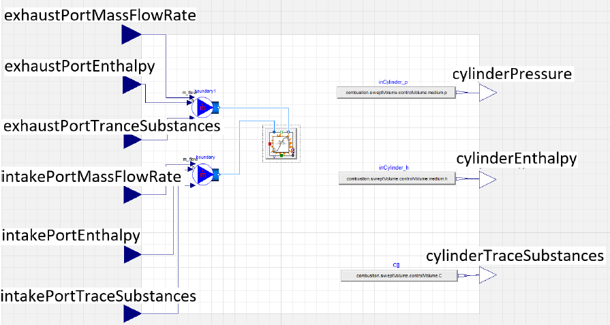
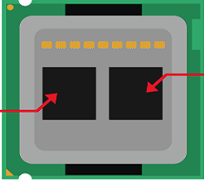
Real-time using multiple cores
Real-time simulation of CAREM
To achieve accurate results from the combustion model time steps of less than 200 microseconds is required (50-100 is better) due to the fast pressure and temperature transients
Most HiL systems now have multiple cores
An engine model can be thought of as a number of tightly couple systems:
Intake, exhaust, combustion and mechanics
One approach is to split the model so that each part runs on its own core
Intake and exhaust system
Combustion
Multi-core processor
Core 2
Core 1
Feedback loops

Slide 7
Problems with this approach
Feedback loop
The intake and exhaust systems running on core 1 and the combustion running on core 2 are highly interconnected, i.e. have feedback loops
The outputs of intake and exhaust system model are fed into the combustion model whose own outputs are in turn fed back as inputs to the intake and exhaust systems
This leads to delays in the feedback loop
As these form part of a discontinuous and nonlinear system it can render real-time performance unattainable and/or inaccurate
Multi-core processor
Combustion
Core 2
Core 1
Feedback loops

Slide 8
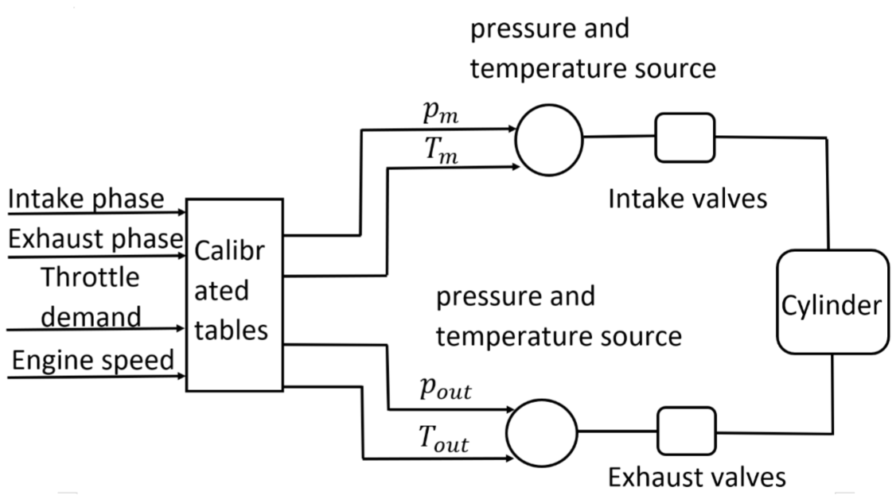
A potential solution
Replace the intake and exhaust system models with tables
Intake and exhaust systems are calibrated off-line for each operating point
The calibrated model is then used to replace fluid based intake and exhaust systems.
However, the fixed boundary conditions and interpolation between calibration points in the tables reduce the accuracy of the resulting simulation
Core 1
Core 2

Slide 9
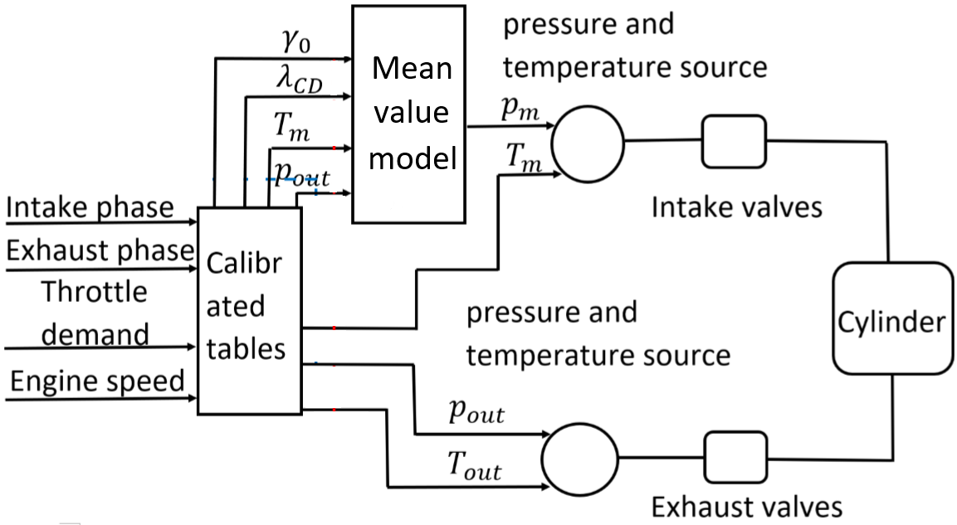
Refining this approach
Fluid dynamics of the intake and exhaust is much slower than the combustion dynamics
Introduce a mean value model into the combustion part of the model
What is a mean value model ?
Cycle averaged continuous model
neglects the reciprocating behaviour of the engine
based on reduced mass and energy balance equations
Physical model that runs faster than CAREM, which makes it suitable for real-time applications
Mean value model now calculates change in pressure based on mass and energy balance
Inputs are mass flow rate through throttle and volumetric efficiency from calibration tables
Core 1
Core 2

Slide 10
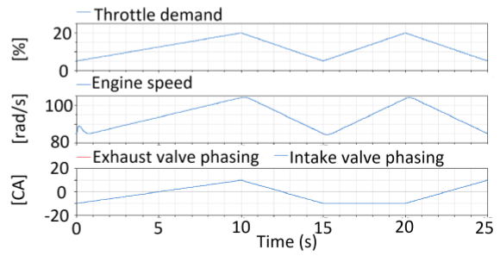
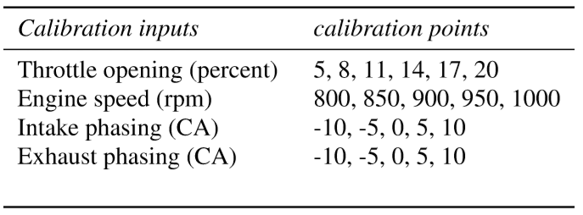
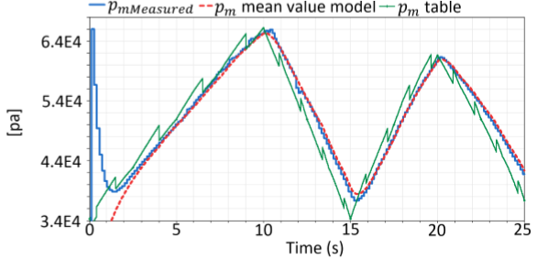
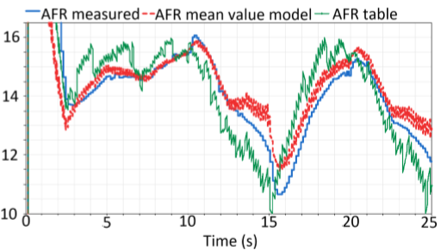
Performance evaluation
Comparison of full CAREM model and the new approaches
For both MVEM based scheme and non-MV based scheme
MVEM based scheme (red dotted)
Non-MVEM, table based scheme (green solid)
Full CAREM intake model (blue solid).
Tables calibration at the following operating points
These results are with a 3% calibration interval for throttle opening
Increasing the throttle opening to 10% calibration intervals can maintain the same level of accuracy between MVEM and CAREM models

Slide 11
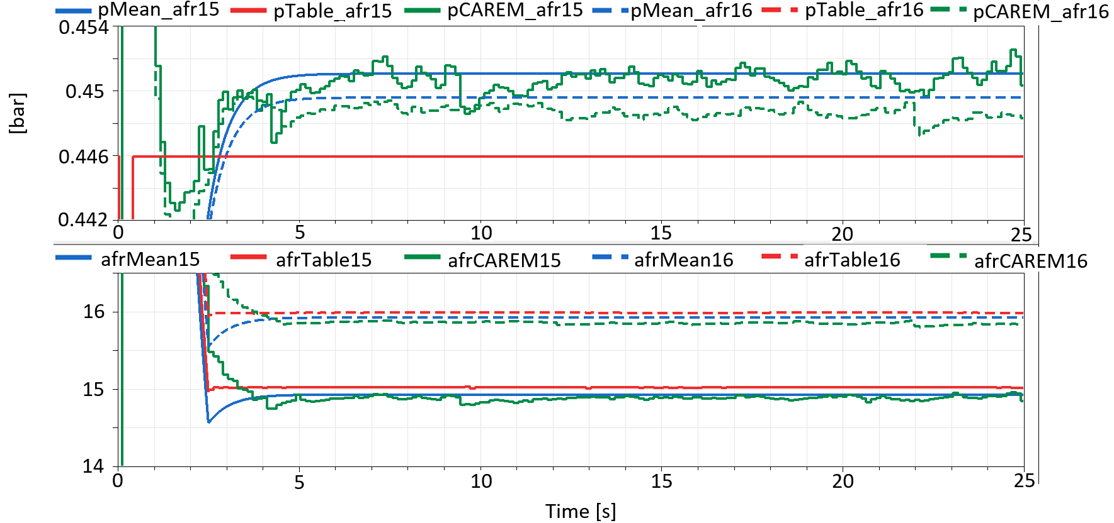
AFR dependent MVEM
The MVEM is formulated such that AFR variation can be compensated by the model
Two results with AFR=15 and AFR=16
Plenum pressure decreases due to leaner AFR
Without calibration against leaner AFR, MVEM intake with CAREM combustion is able to calculate the decreased plenum pressure due to learner AFR
Without the MVEM component, the plenum pressure remains insensitive to AFR variation unless the calibration tables include this extra dimension

Slide 12
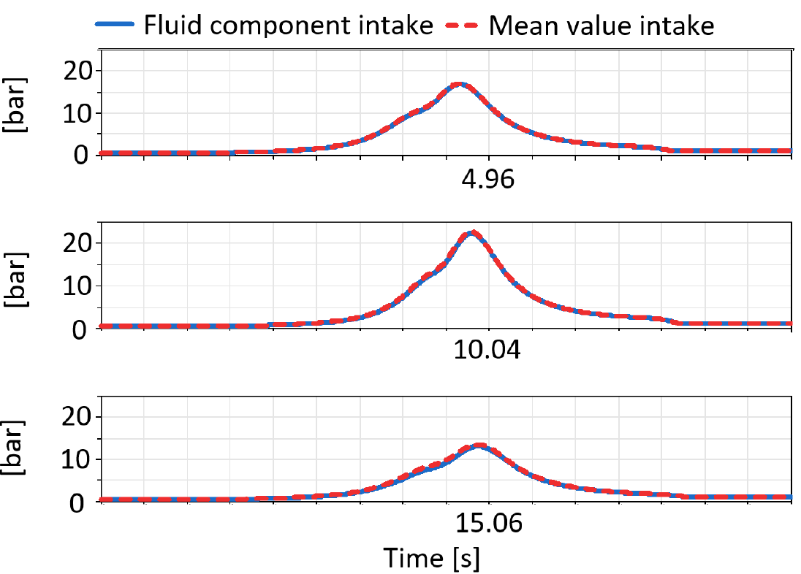
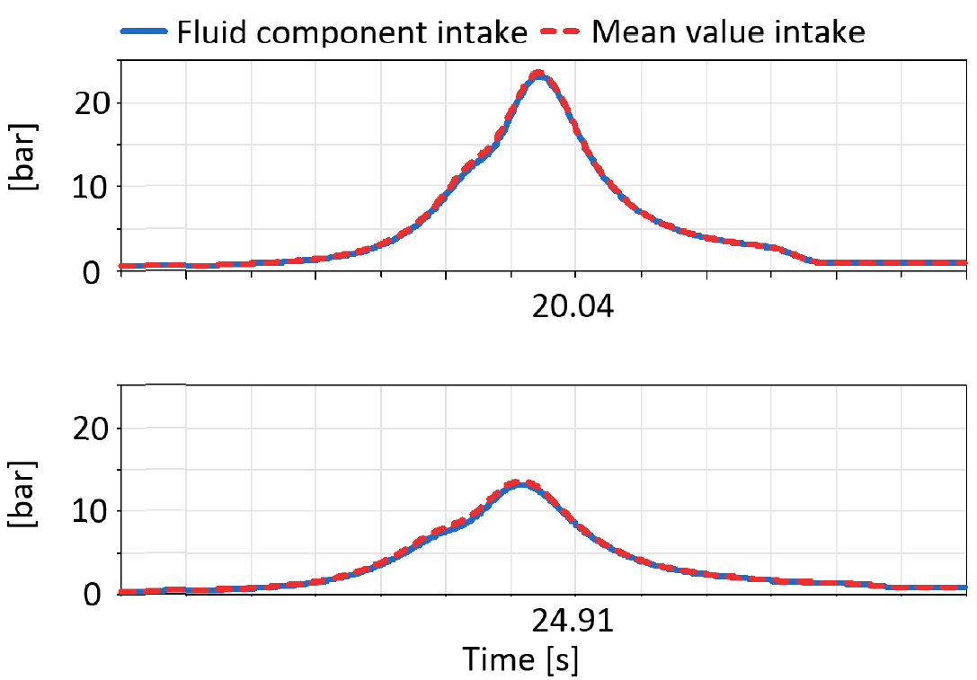
Cylinder pressure profile from MVEM intake with CAREM combustion
Comparison of in-cylinder pressures at different operating points
Hybrid approach compared to full, non-real-time CAREM model

Slide 13
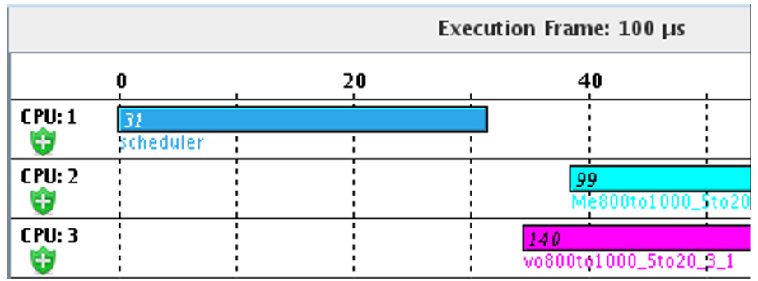
Allocating on hardware
Hardware specification
A quad-core Concurrent test rig, each core having 2.5 GHz clock rate and 3.9 GB Ram, with RedHawk Linux operating system is used to evaluate the real-time performance of the MVEM intake with CAREM combustion.
Core 2 runs the mechanical components (pistons, crankshaft, camshaft), ECU (generate command for throttle opening, valve phasing, speed, injection and spark timing), and calibrated tables.
Core 3 runs CAREM combustion with MVEM intake
The execution frames for two models on separate core are shown in the plot on the right below. Model in core 3 consumes more computational resources than in Core 2.
Core 2
Execution frame for mechanical model on core 2 and MVEM
intake with CAREM combustion on core 3
Core 3

Slide 14
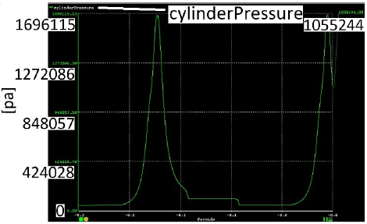
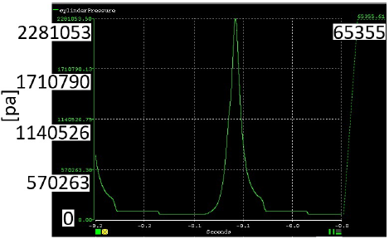
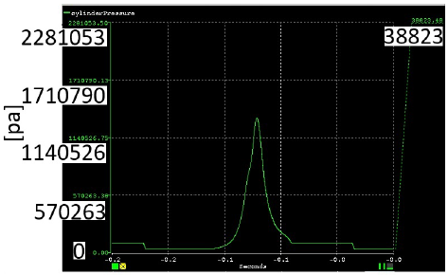
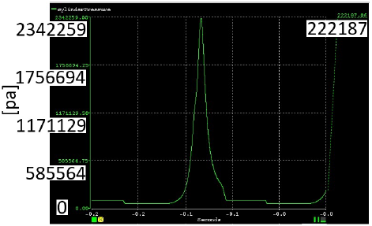
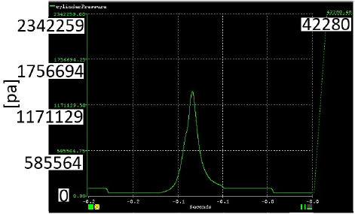
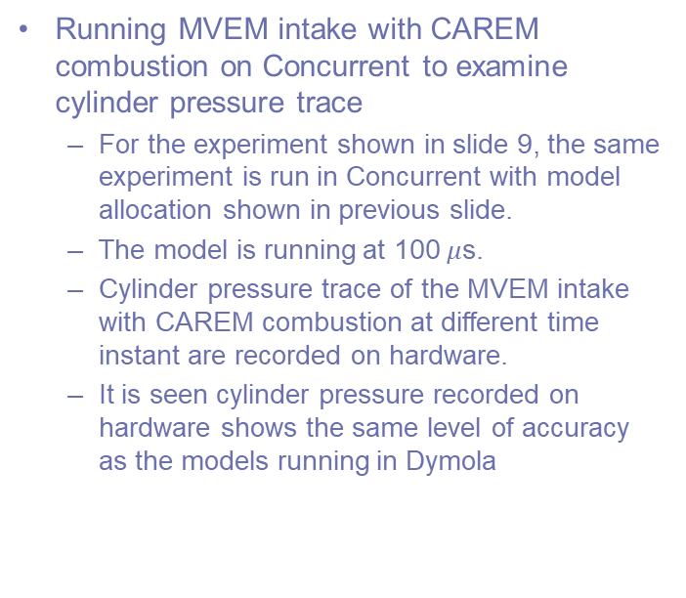
Real-time performance of MVEM intake with CAREM combustion on hardware
Running MVEM intake with CAREM combustion on Concurrent to examine cylinder pressure trace
For the experiment shown in slide 9, the same experiment is run in Concurrent with model allocation shown in previous slide.
The model is running at 100 $μ$s.
Cylinder pressure trace of the MVEM intake with CAREM combustion at different time instant are recorded on hardware.
It is seen cylinder pressure recorded on hardware shows the same level of accuracy as the models running in Dymola
5s
10s
15s
20s
25s

Slide 15
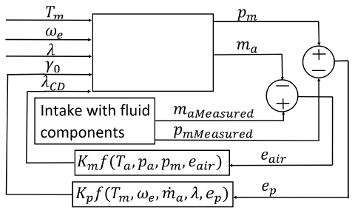
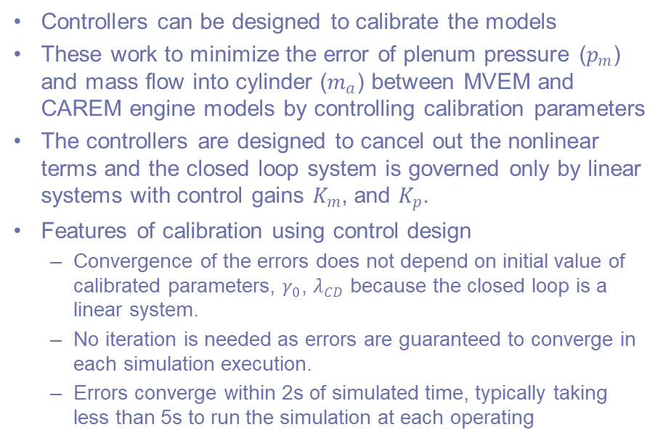
Calibration of MVEM using control design
Controllers can be designed to calibrate the models
These work to minimize the error of plenum pressure ($p_{m}$) and mass flow into cylinder ($m_{a}$) between MVEM and CAREM engine models by controlling calibration parameters
The controllers are designed to cancel out the nonlinear terms and the closed loop system is governed only by linear systems with control gains $K_{m}$, and $K_{p}$.
Features of calibration using control design
Convergence of the errors does not depend on initial value of calibrated parameters, $γ_{0}$, $λ_{CD}$ because the closed loop is a linear system.
No iteration is needed as errors are guaranteed to converge in each simulation execution.
Errors converge within 2s of simulated time, typically taking less than 5s to run the simulation at each operating
Mean value model

Slide 16
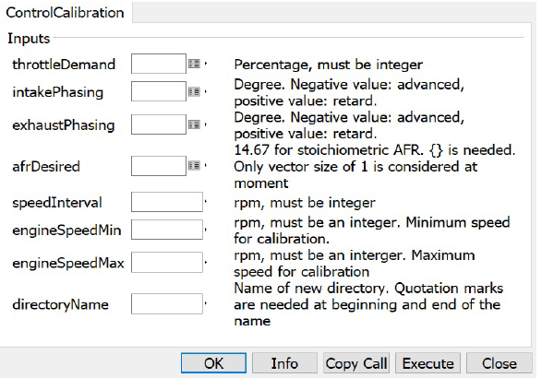
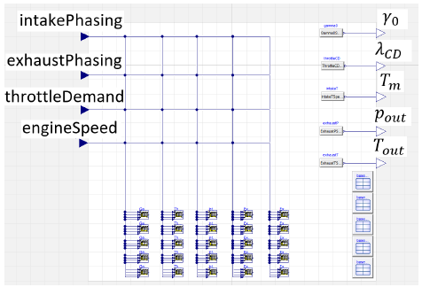
Automated calibration for MVEM
A function can be created to automatically calibrate MVEM for all the operating points user has specified
In the automatically generated calibration tables, the number of rows corresponds to the number of engine speed points. The number of columns corresponds to the number of calibration parameters.
Function for automated calibration
Automatically generated calibration tables

Slide 17
Summary
It has been shown that the MVEM is efficient and accurate to be used for CAREM simulation on hardware for real-time performance
The MVEM can account for AFR variation, so number of calibration points against AFR can be reduced
Calibration using controller design is efficient
On average it takes 2 to 5 seconds to run 2 second of simulation to calibrate MVEM for each calibration point
This is practically acceptable, given the amount of operating points to be calibrated.
Automated calibration has been implemented to improve efficiency and accuracy

